Slide 1

Problem Solving Session
The remainder of today’s class will comprise the problem solving session (PSS).
Your instructor will divide you into teams of 3 or 4 students.
Each team will work together to solve the following problems over the course of 20-30 minutes.
You may work on paper, a white board, or digitally as determined by your instructor.
You will submit your solution by pushing it to GitHub before the end of class.
Your instructor will go over the solution before the end of class.
If there is any time remaining, you will begin work on your homework assignment.
Class participation is a significant part of your grade (20%). This includes in class activities and the problem solving session.
Your Course Assistants will grade your participation by verifying that you pushed your solutions before the end of the class period each day.

Slide 2
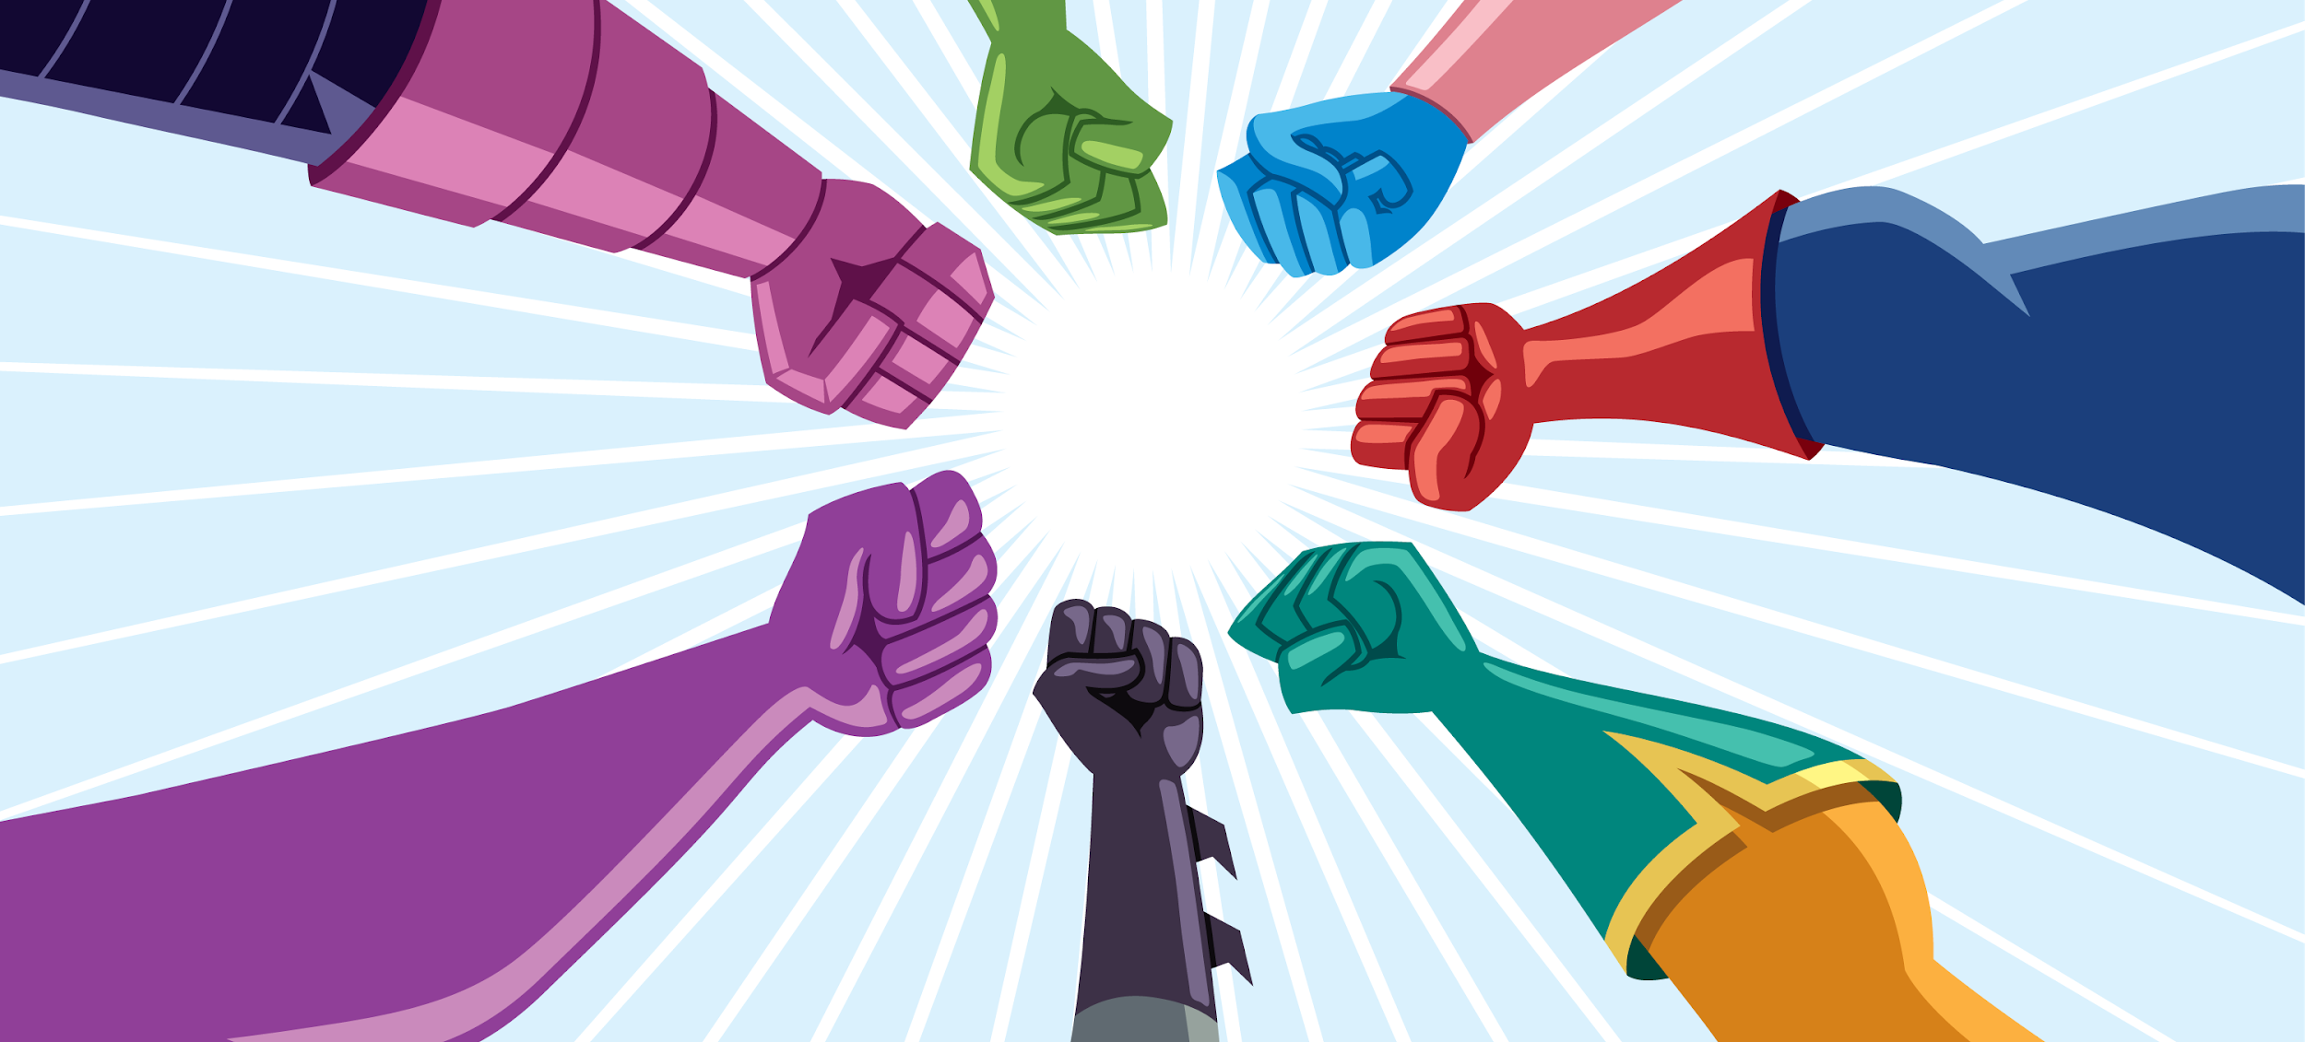
Problem Solving Team Members
Ben Eggers
Xander Toamszewski
Logan Costa
Lukas May
Record the name of each of your problem solving team members here.
Do not forget to add every team member’s name! Your instructor (or course assistant) may or may not use this to determine whether or not you participated in the problem solving session.

Slide 3
Coming Up
SUN | MON (4/1) | TUE | WED (4/3) | THU | FRI (4/5) | SAT
 | Unit 10: Concurrent Programming |  |  |  | Midterm Exam III
 | Unit 9 Mini-Practicum |  | Project Part 1 Due (start of class) |  | Units 7-9 Written 30% Practicum 70%
SUN | MON (4/8) | TUE | WED (4/10) | THU | FRI (4/12) | SAT
 | Project Time |  | Unit 11: Thread Cooperation
 | Project Part 2 Team Problem-Solving Assignment 10.1 Due (start of class) |  | Unit 10 Mini-Practicum |  | Project Part 2 Due (start of class)
You Are Here

Slide 4
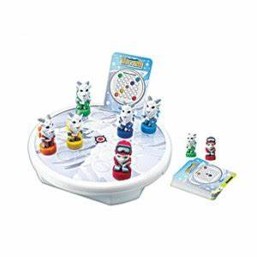
Pete's Pike
Pete's Pike is a logic game where the goal is to get Pete the mountain climber safely to the top of the mountain. Pete is accompanied by his trusty goats who will assist him in his journey.
Pete and his goats, collectively known as pieces, can move either horizontally or vertically. However, if there is no other piece in the direction they are moving, they will slide off the mountain to certain doom. If there is a piece in the direction of the move, the moving piece will stop at the space directly before the stationary piece.
The game ends when either Pete is on the space designated as the mountaintop or there are no valid moves remaining.
Pete's Pike board game was released by Thinkfun in 2007.

Slide 5


Pair Programming
Pair programming is a technique during which two developers collaborate to solve a software problem by writing code together.
One developer takes on the role of the driver.
Shares their screen.
Is actively writing code.
The other developer(s) takes on the role of the navigator.
Watches while the driver codes.
Takes notes.
Asks questions.
Points out potential errors.
Makes suggestions for improvements.
The driver and navigator regularly switch roles, e.g. every 10-20 minutes.
Set a timer!
Push your code!
For the rest of today's problem solving session, you and your team will practice pair programming with one team member acting as the driver and the remaining team members acting as the navigators.
Everyone on the team should take a moment to watch this short video on pair programming.
When you are the driver, you should be using Zoom or Discord to share your screen. Be sure to push your code and switch roles every 10-20 minutes!

Slide 6
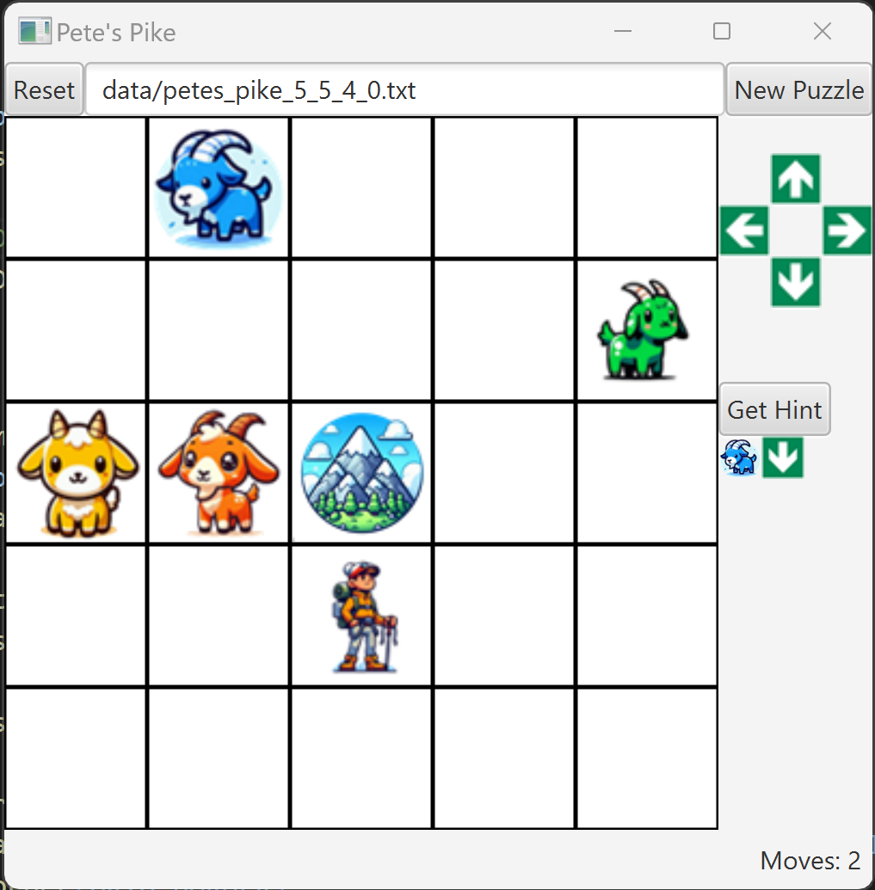
GUI Design
You have freedom in the look-and-feel of your GUI, but your application must
Display the a current status of the game, including
A new game has been started.
Whether or not a move was valid, and if invalid, the reason why.
When the game has been won.
A hint
Display and update the number of moves as the game progresses.
Display up to a 9x9 board with a mountaintop space.
Display all pieces at their current positions on the board.
There must be a means to move each piece horizontally or vertically.
Provide a means for the user to request a hint
How the hint is displayed to the user is up to you as long as it is clearly visible.
The hint should be cleared after the next move.
Provide a means for the user to
Reset the game.
Start a new puzzle.
Be creative!
It's permissible to use an AI image tool such as DALL-E to generate images for your game.
Using paper, whiteboard, or a drawing application, sketch out your GUI design.
Indicate which JavaFX controls you will use for each aspect of the GUI.
Upload an image of your GUI design to your data directory of your repo.

Slide 7
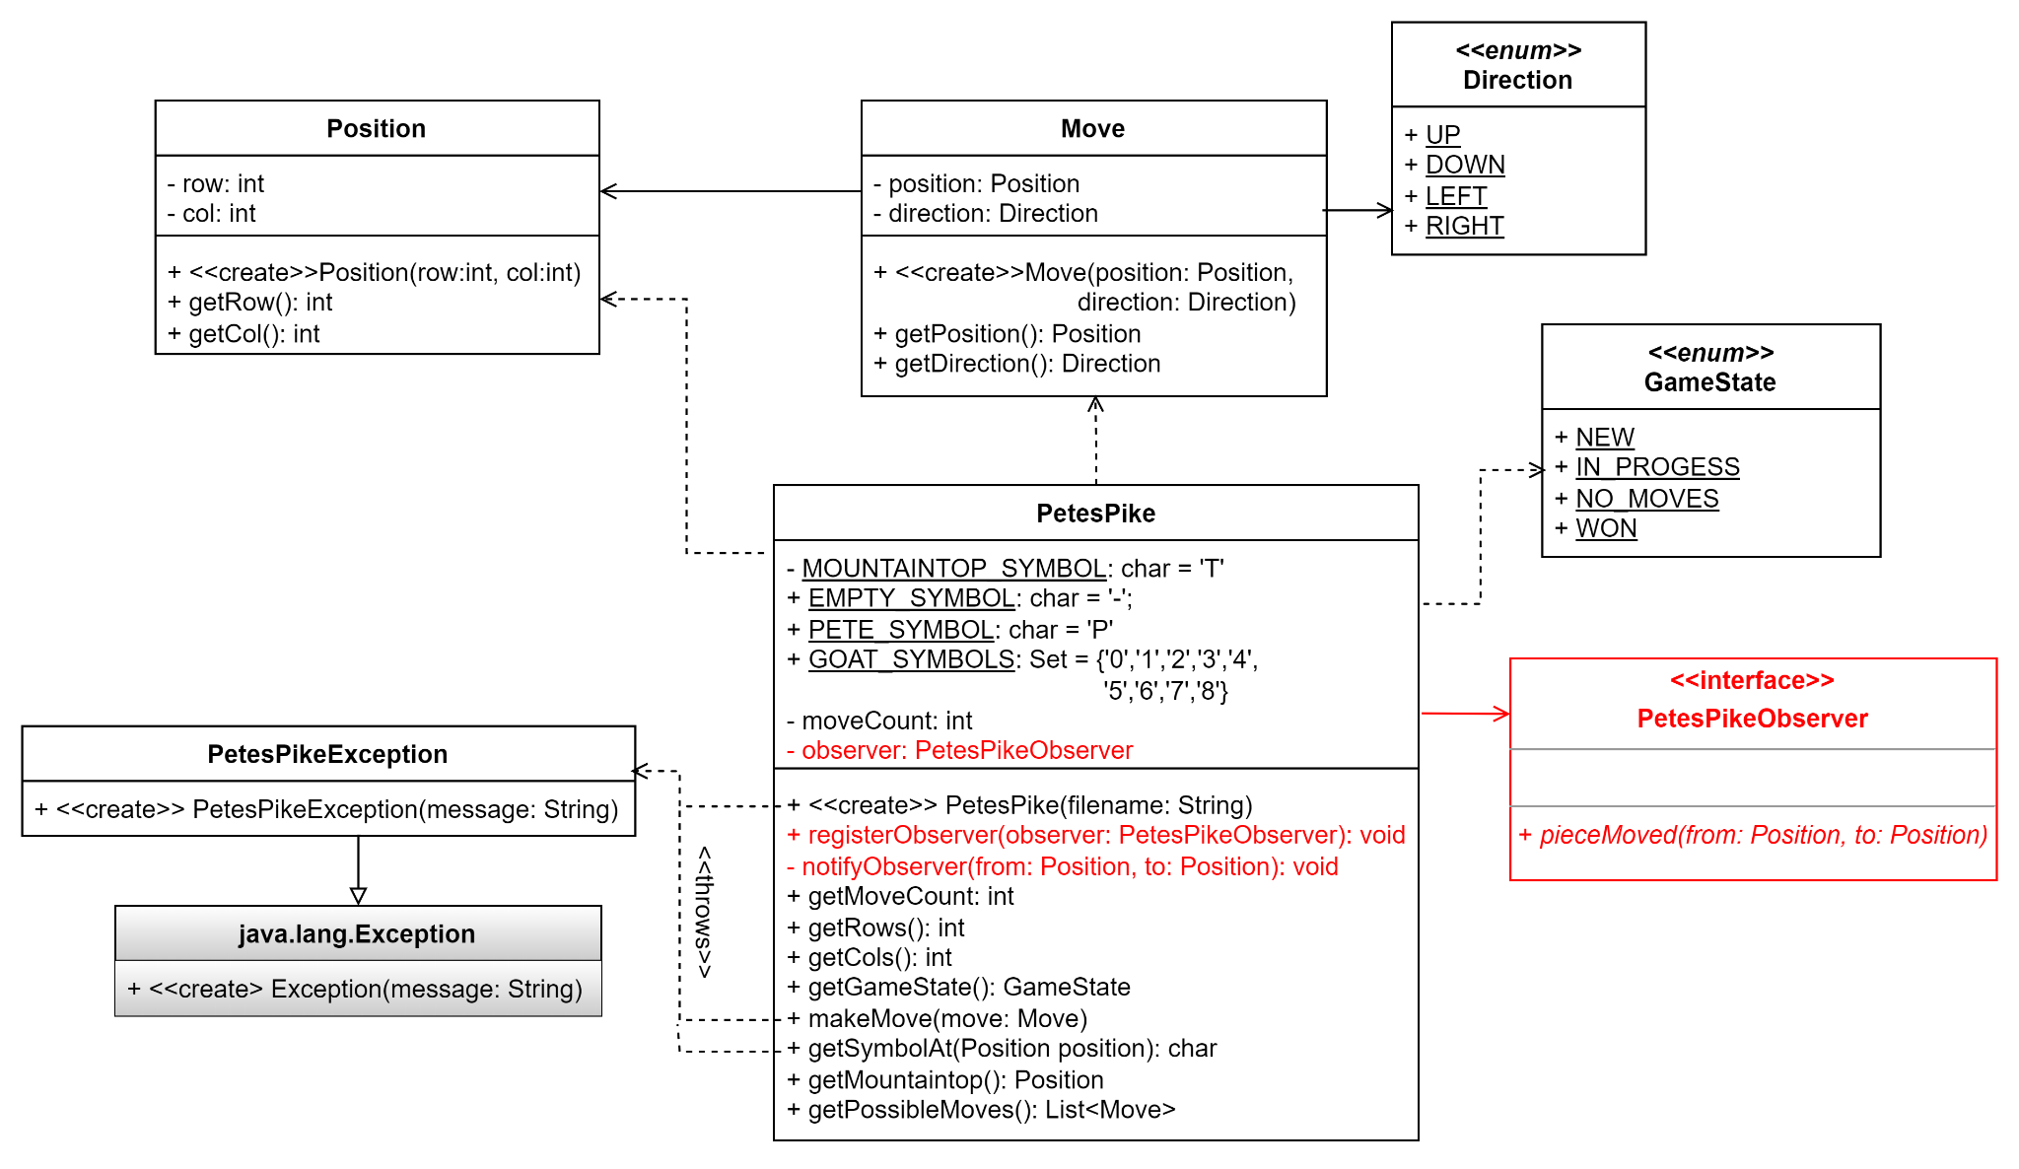
An Enhanced Partial Design
Refer to this full UML class diagram as needed while you and your team work through the rest of this assignment.

Slide 8
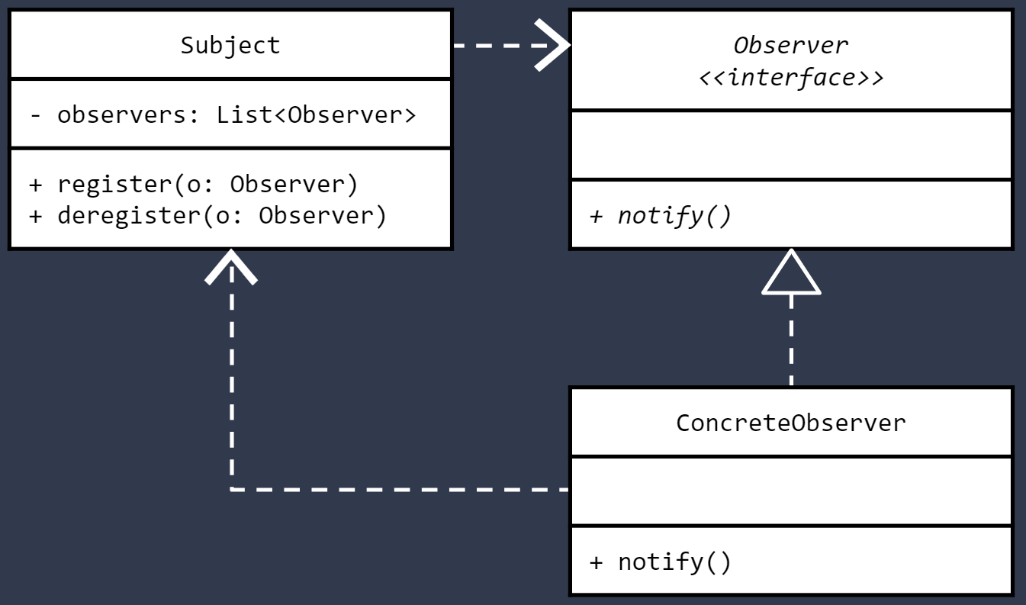
Review: The Observer Design Pattern
The Observer Design Pattern is a software design pattern in which there is some subject of interest.
We'd like to know when something interesting happens to the subject.
The subject maintains a list of interested observers.
Each concrete observer implements the same interface.
The interface defines a method that can be used to notify the observer when something interesting happens.
This semester, we have implemented the Observer Design Pattern when writing graphical user interface (GUI) applications.
To handle a user initiated event in the GUI, such as clicking on a button.
A small class or lambda expression that implements the EventHandler<ActionEvent> interface is registered with the control.
When the event occurs, the implementing code typically calls a method in a model class to effect a state change.
To update the GUI when a model state change has occurred.
A small class or the GUI application itself implements the observer interface defined by the model
The model notifies the observers of the state change by calling an observer interface method and the GUI is updated to reflect the change.
In the Observer Pattern, the Subject maintains a list of Observers that should be notified whenever something interesting happens.
Classes that implement the Observer interface can register to be notified.

Slide 9
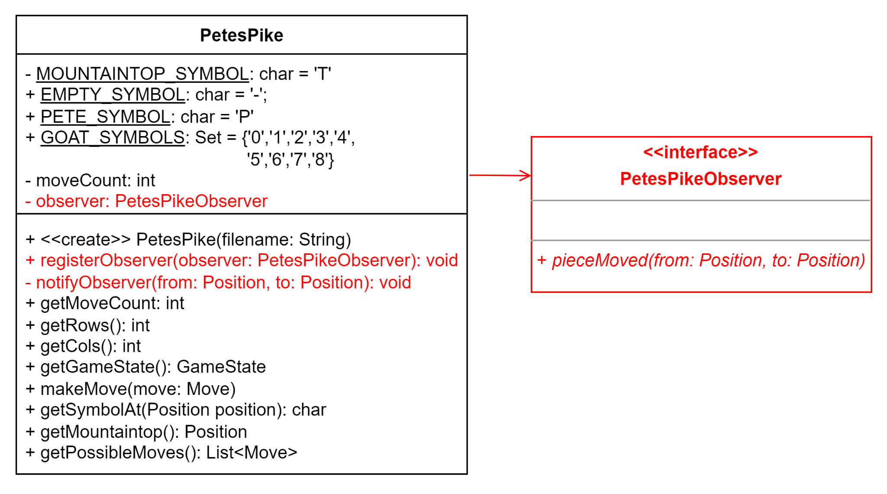
Observing Change
To support your GUI, you will need to make some changes to your model package.
Use the UML to the left to guide your implementation of the highlighted items
PetesPikeObserver - an interface that receives notifications when a piece has successfully moved.
PetesPike - the main class containing the game logic and maintains the game state.
registerObserver - registers an observer that wishes to be notified when a piece has moved.
notifyObserver - notifies an observer that a piece has moved by providing the original Position of the piece and the Position where the piece stopped.
Next, you and your team should begin implementing these changes.
You will need to update other PetesPike methods to make calls to notifyObserver.
Remember to practice pair programming during your implementation.

Slide 10
Meeting Times
Date/Time | Location | Area of Focus
4/9 @ 1:00PM | Discord | Observer
4/10 @6:00PM | Discord | Overall GUI
This part of the project is due Friday April 12th, 2024 at the start of class.
You should plan to work together as much as you can, even if that means setting up a remote meeting using Zoom or Discord.
Plan at least 2 meetings over the course of this part of the project. Each meeting should be at least 1 hour. Following the example on the right, put the information for all scheduled meetings in a meetings.txt file and push to your repository.

Slide 11

If You Made it This Far...
Your team is off to a good start, but you are not quite finished with Part 2 of the Project yet.
Not quite...
You still need to create a working implementation of Pete's Pike that can be played by a single human user via a graphical user interface.
If you have time remaining in class, you should begin reading the full project description, which you will find on MyCourses.

